Slide 1
Design Wrap-up
It 426

Slide 2
Refactoring
“Paying down your technical debt” – Agile Samurai, Jonathan Rasmuss0n
Our debt is comprised of our daily decisions in code
Bad names, hacks, duplicated code, poor design choices, disproportionate complexity, sloppiness…
Refactoring: renaming, rearranging, redesigning and rewriting existing code

Slide 3
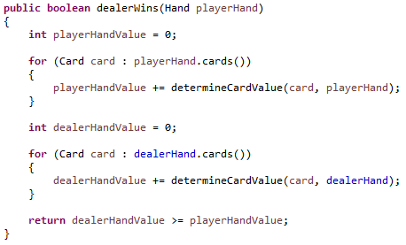
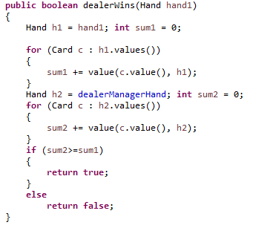
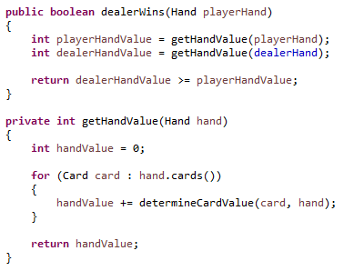
Refactoring

Slide 4
Some patterns you may want to read about
Object relational mapping (ORM)
Mapping
Classes → table schemas
Objects → table records
Columns → class fields
Java Persistence Api / Spring Framework
Active record pattern
“An object that wraps a row in a database table or view, encapsulates the database access, and adds domain logic on that data.” - Martin Fowler
sync
Java Class
DB

Slide 5
Thinking in terms of interfaces
Changing to an interface first mindset can be difficult at first
This is how we keep our code flexible!
Solving a problem:
Discover the behavior
Define any varying behavior behind a(n) [interface, abstract class]
Design for the future
What part of your solution might change in the future
Plan accordingly!

Slide 6
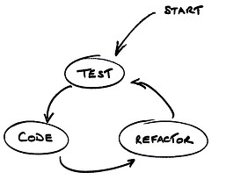
Thinking in terms of tests first
Test Driven Development (TDD)
What is the behavior of a system?
Can you define the features of a system without first writing code?
If you can, then you can
First write your tests
Then write your production code to satisfy the test

Slide 7
Some last thoughts
“Getting software to work and making software clean are two very different activities.” – Robert Martin
Don’t neglect the latter!
We are not done when our “code works”

Slide 8
Sources
Martin, Robert C. Clean Code. New Jersey: Pearson Education Inc, 2009.
Rasmusson, Jonathan. The Agile Samurai. Dallas, Texas: Pragmatic Programmers, 2010.

Slide 9
Design Wrap-up
It 426

